Slide 1
homeostasis
Year 11 Biology
Bremer SHS

Slide 2
Warm up questions
Explain why placing celery stalks in coloured water causes discolouration of the leaves.
Describe the processing necessary before ingested food can be absorbed by body cells.
Oxygen moves out of the blood and in to body cells. Justify why using information from the table below.
Table 1 – oxygen content in the human body.
 | Capillary Entering Muscle Cell | Muscle Tissue | Capillary Leaving Muscle Tissue
Oxygen Content (kPa) | 90 | 43 | 42

Slide 3
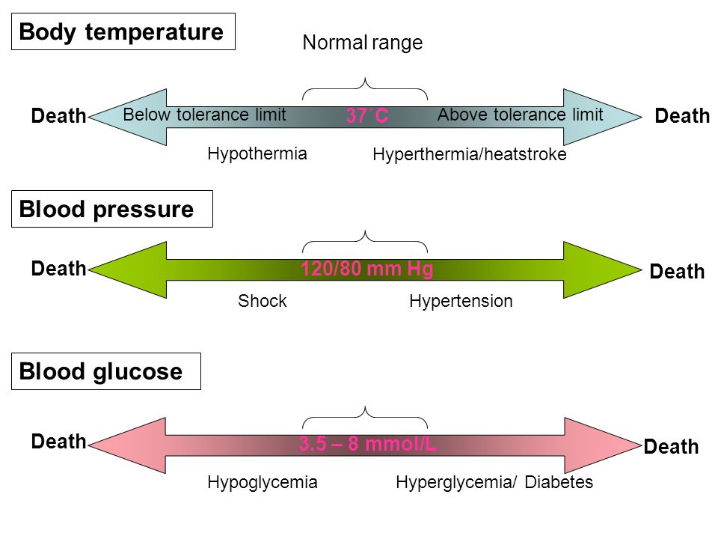
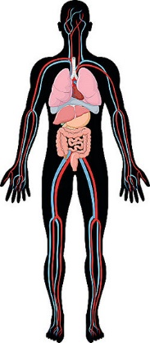
The internal environment
Can you name any other internal factors that are controlled?

Slide 4
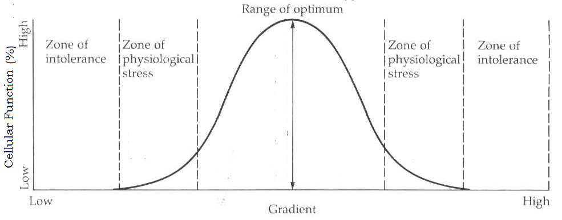
homeostasis
Homeostasis is the maintenance of a relatively stable internal environment.
Some factors controlled by homeostasis include temperature, oxygen saturation, pH, blood glucose and waste concentration.
Homeostasis works to maintain conditions within very small tolerance limits.

Slide 5
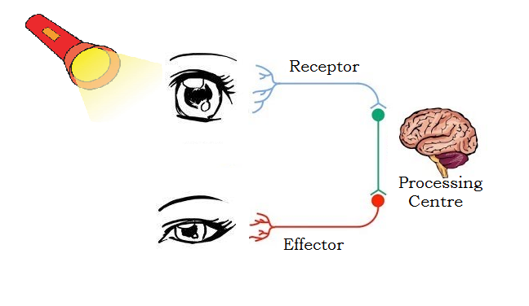
Stimulus response model
Organisms must use a feedback mechanism to quickly identify and control disturbances to homeostasis.
The stimulus-response model represents the feedback mechanism used to control the internal environment.
The stimulus-response model use receptors that detect disturbances, a processing centre that interprets and coordinates a response and an effector that carries out the response.
Receptor
Processing Centre
Effector

Slide 6
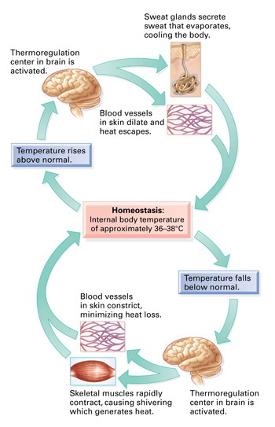
Negative feedback
Negative feedback is a mechanism that counteracts the effect of the original stimulus.
Negative feedback tends to produce internal stability.
Thermoregulation and blood glucose regulation are examples of negative feedback systems.

Slide 7
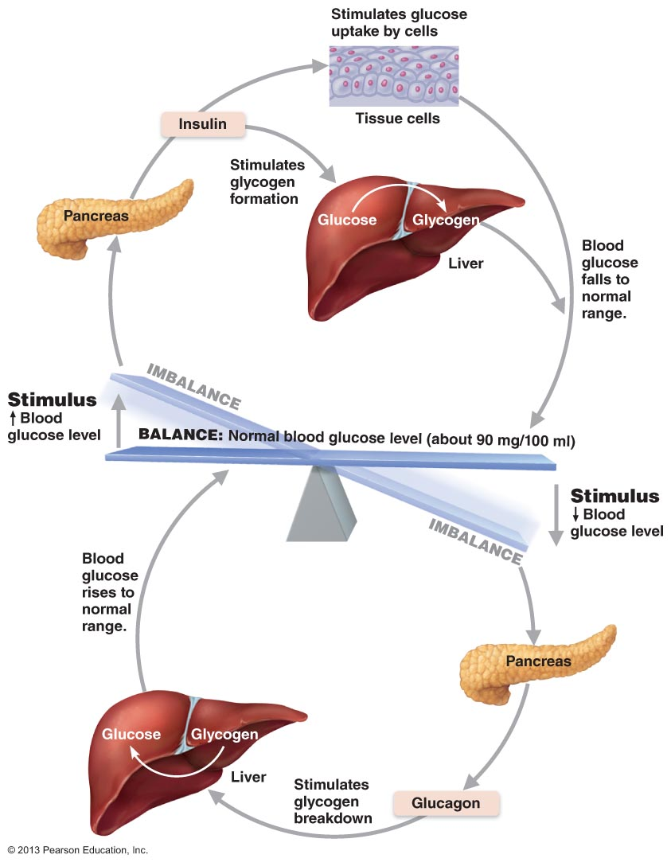
Negative feedback
Outline the role of insulin and glucagon in the negative feedback system that controls blood glucose levels.

Slide 8
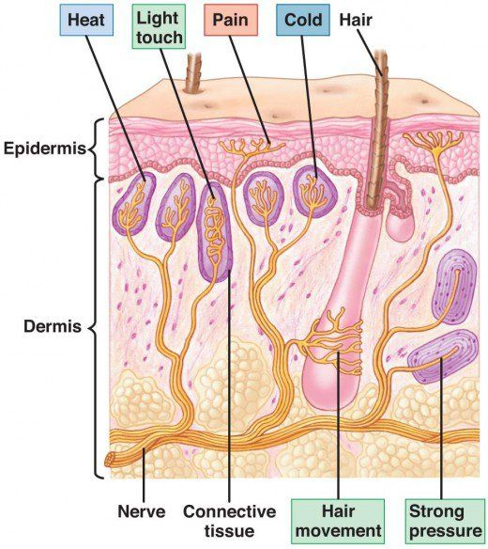
receptors
There are millions of external and internal receptors that allow an organism to respond to stimuli.
Interoceptors receive signals from within the body’s internal environment whereas exteroceptors receive signals from the external environment.
Stimuli may be physical (light, heat, pressure) or it may be chemical (hormones, neurotransmitters).
Receptors are grouped in the five main categories – chemoreceptors, mechanoreceptors, photoreceptors, thermoreceptors and nociceptors.

Slide 9
Types of receptors
Type of Receptor | Examples of Stimuli
Chemoreceptor | Exteroceptors - smells and tastes in the nose and mouth. Interoceptors – oxygen and ion levels in blood vessels.
Mechanoreceptor | Exteroceptors – touch and sound vibrations. Interoceptors – pressure and balance.
Photoreceptor | Exteroceptors – light in the eyes. Interoceptors – none.
Thermoreceptor | Exteroceptors – air temperature on the skin. Interoceptors – internal temperature in the hypothalamus.
Nociceptors | Exteroceptors – painful heat, cold, pressure and light. Interoceptors – painful pressure and tension.

Slide 10
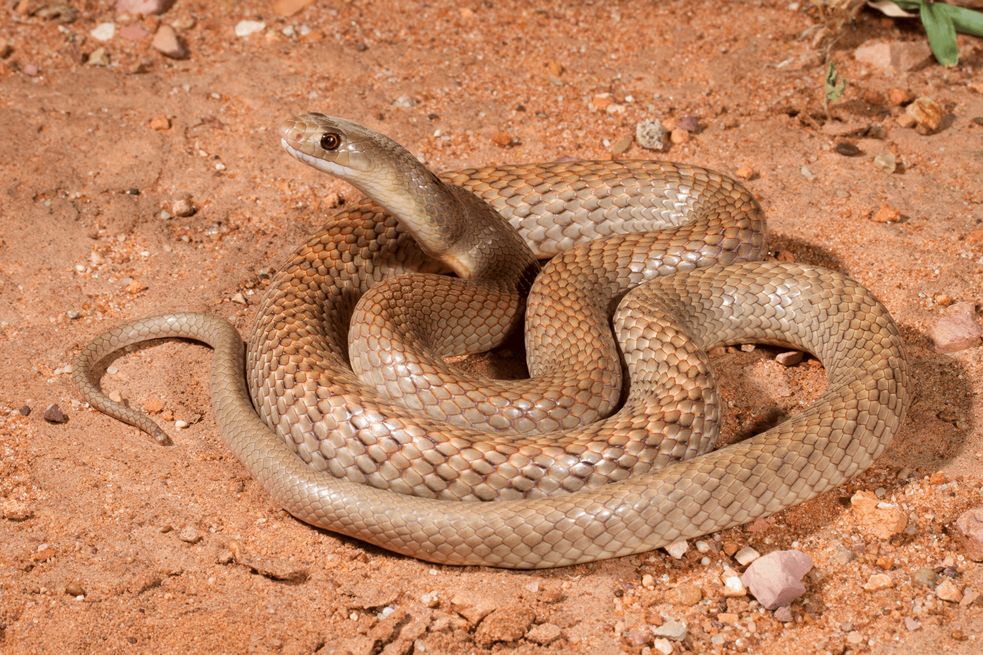
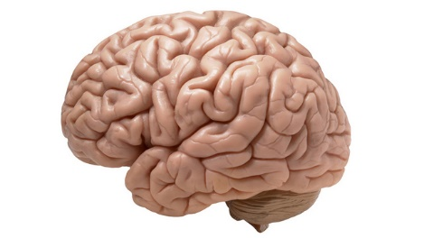
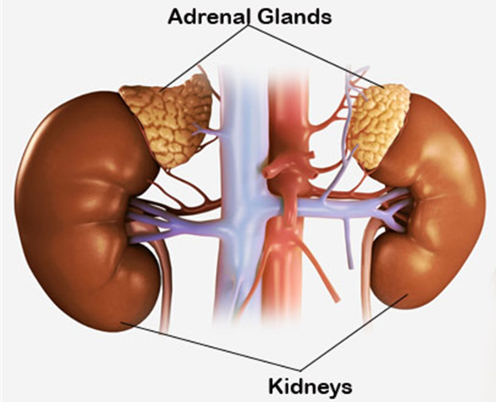
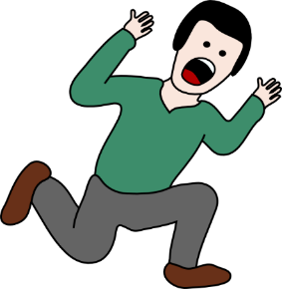
effectors
Stimuli
A response is initiated by an effector to decrease the effect of the stimulus.
Effectors are generally grouped in to two categories: muscles and glands.
Muscles can contract in response to stimuli.
Glands secrete chemicals such as adrenaline and insulin in to the blood stream in response to stimuli.
Processing
Centre
Effectors

Slide 11
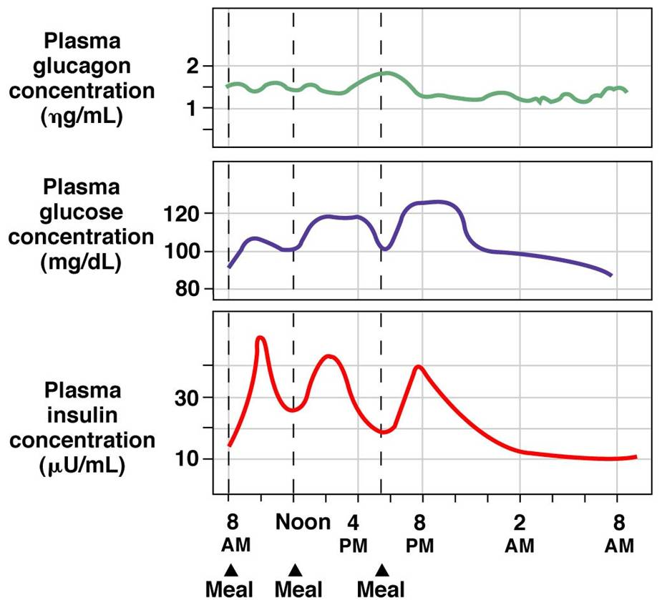
Check for understanding
Blood glucose concentration is controlled by negative feedback. The two hormones involved in glucose metabolism are glucagon and insulin.
Identify a relationship between glucose concentration and insulin concentration.
Identify a relationship between glucagon concentration and glucose concentration.
Make a conclusion about the role of insulin and glucagon based on your previous responses.

